Slide 1
Business Analysis
File created on: 2/28/2022 5:14:04 PM

Slide 2
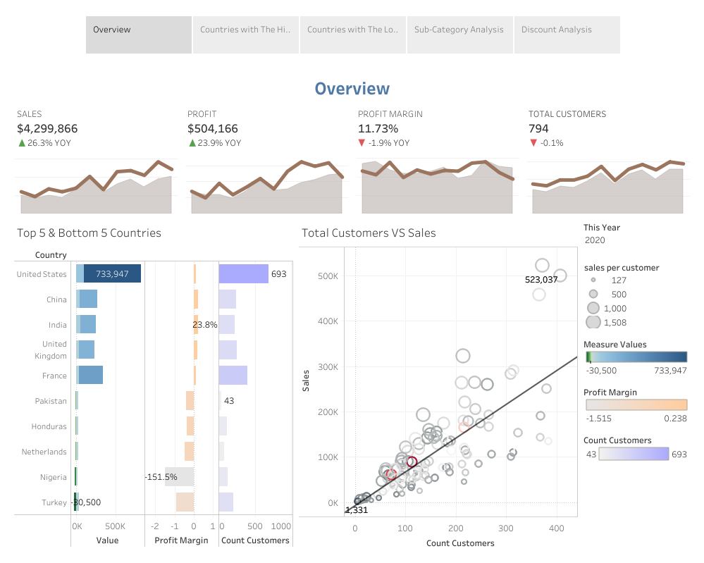

Slide 3
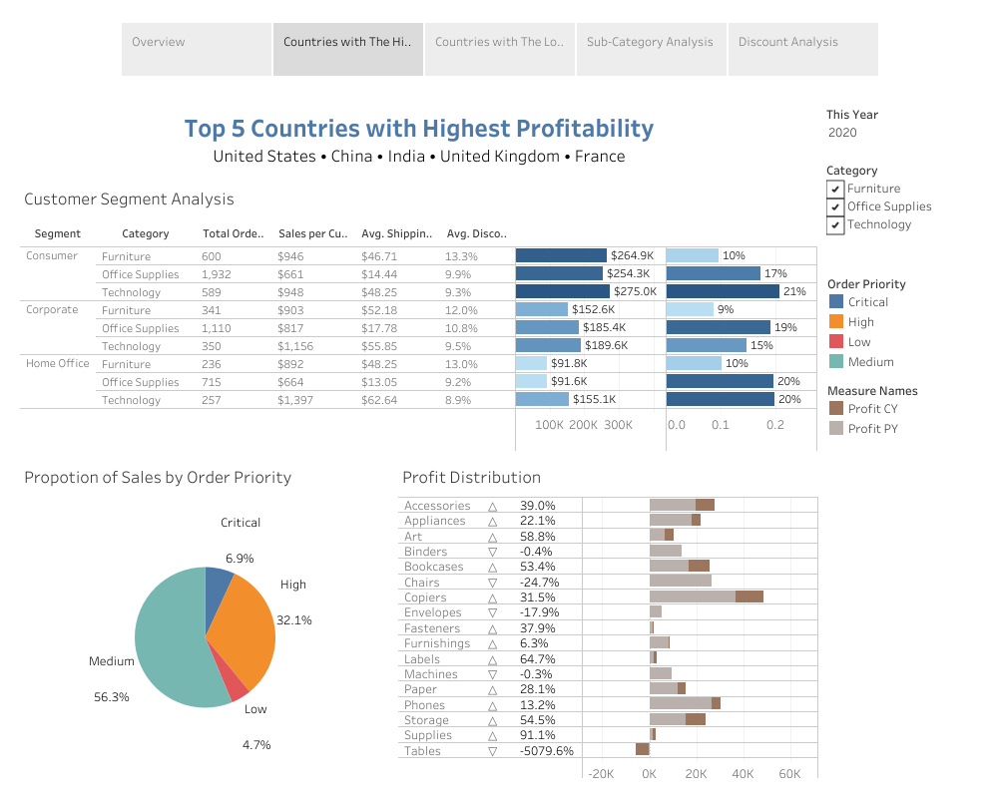

Slide 4
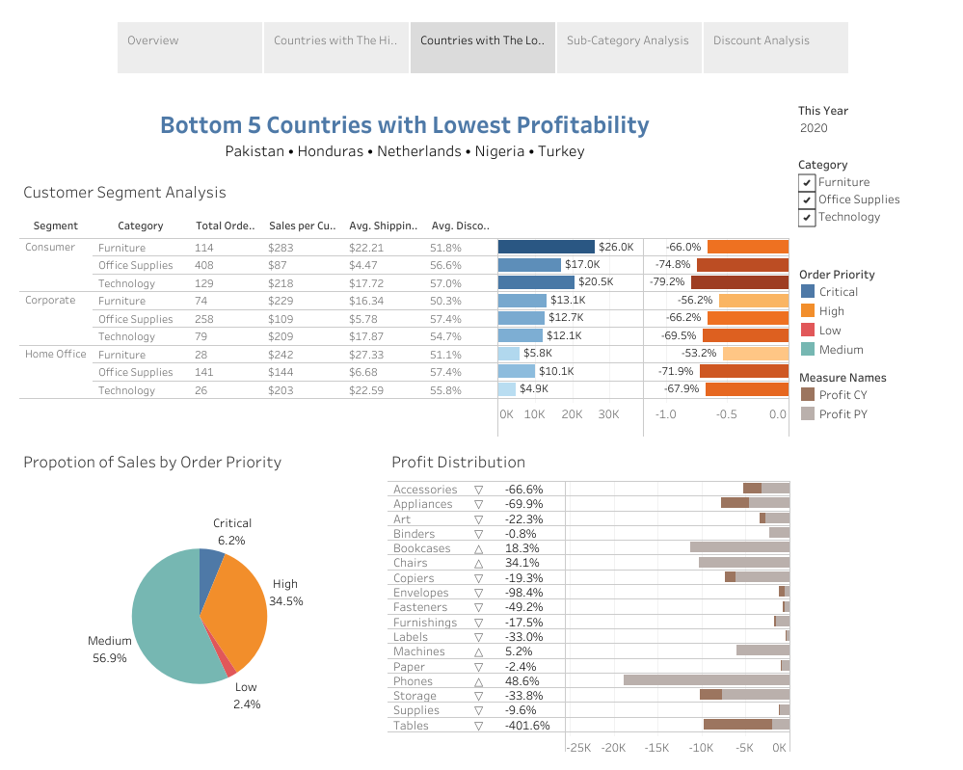

Slide 5
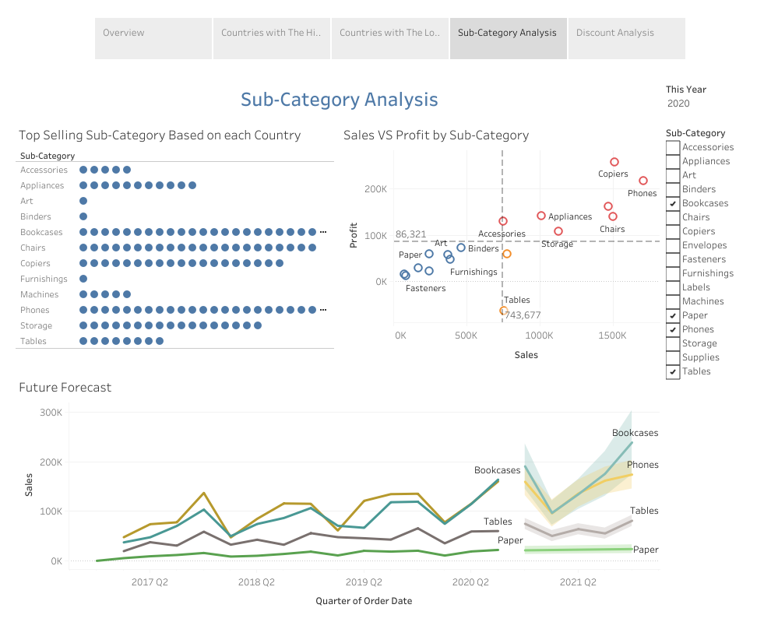

Slide 6
